Slide 1

US AIRLINE SENTIMENT ANALYSIS
Task: Predict the emotion in a feedback
Jesse Annan

Slide 2

Data Set
Tweet ID | Airline Sentiment
Airline Sentiment Conf | Negative Reason
Negative Reason Conf | Airline
Airline Sentiment Gold | Name
Negative Reason Gold | Retweet Count
Text | Tweet Coord
Tweet Created | Tweet Location
User Time zone
Data set shape: 14640 x 15

Slide 3
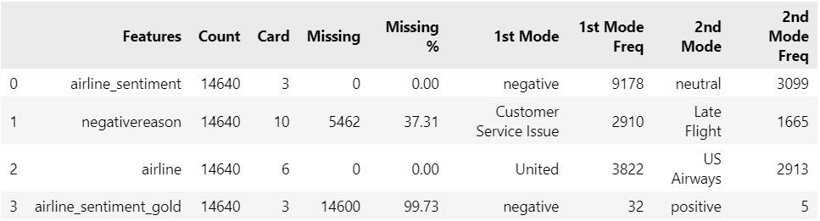
DATA PRE-PROCESSING Data Quality Report

Slide 4
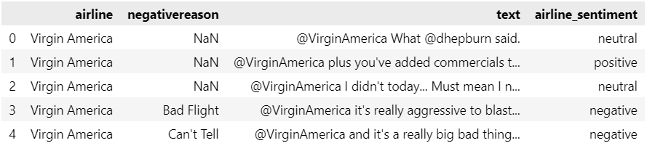
DATA PREPROCESSING Removing stop words, reserved words and tags
Removed features with over 50% missing, removed https, @, emojis, and regs

Slide 5
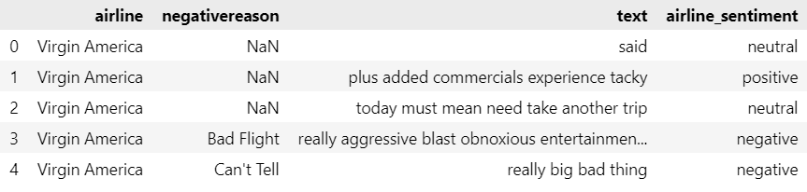
DATA PREPROCESSING Removing stop words, reserved words and tags
Removed features with over 50% missing, removed https, @, emojis, and regs

Slide 6
SENTIMENTS
62.69%
Negative
21.17%
Neutral
16.14%
Positive

Slide 7
SENTIMENTS
1960 | 463 | 336
2263 | 381 | 269
American
US Airways
955 | 723 | 544
2633 | 697 | 492
Delta
United
1186 | 664 | 570
181 | 171 | 152
Southwest
Virgin America

Slide 8
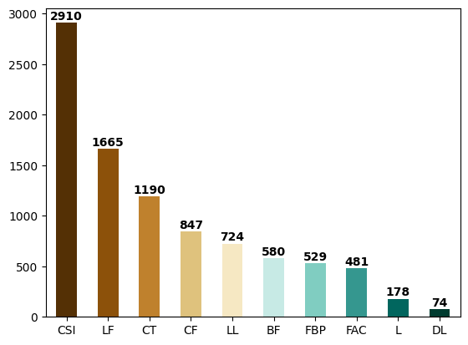
NEGATIVE REASONS
CSI: Customer Service Issue
LF: Late Flight
CT: Can't Tell
CF: Cancelled Flight
LL: Lost Luggage
BF: Bad Flight
FBP: Flight Booking Problems
FAC: Flight Attendant Complaints
L: longlines
DL: Damaged Luggage

Slide 9
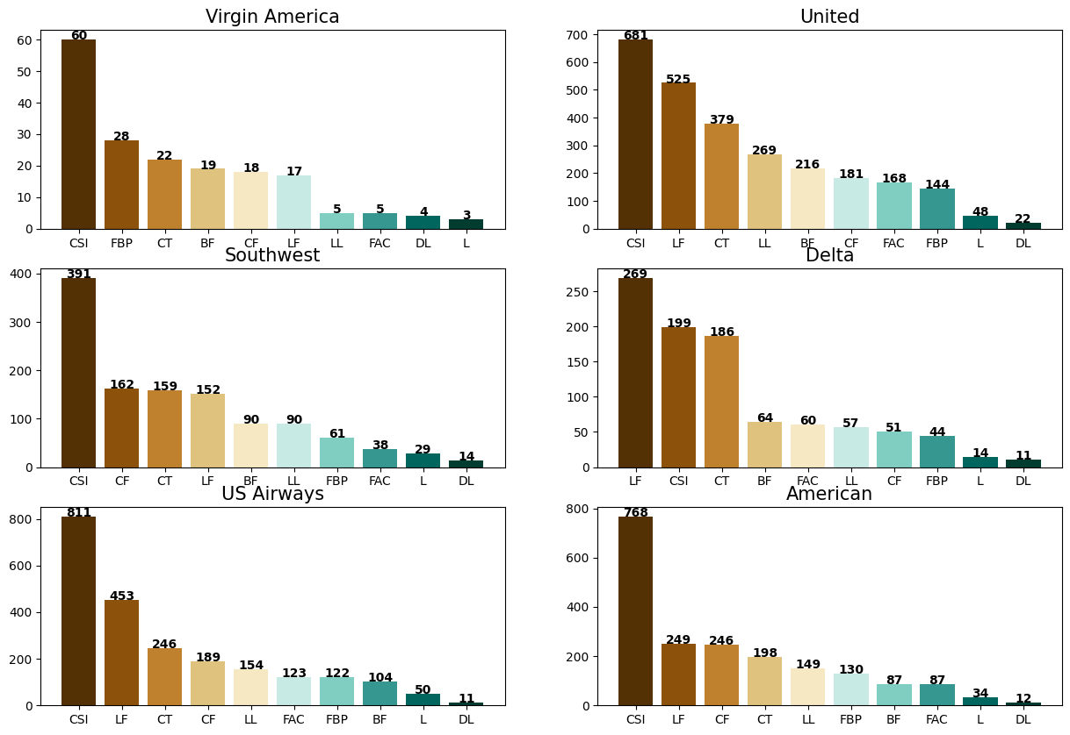
BIG IMAGE

Slide 10
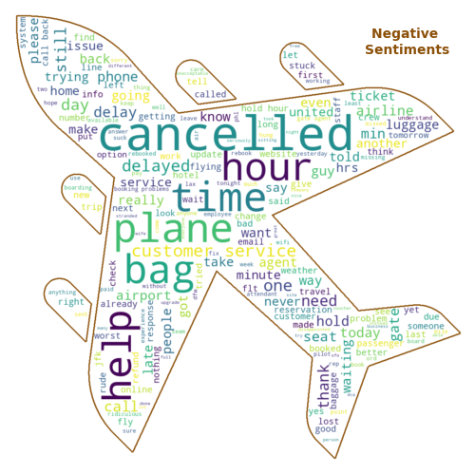

Slide 11
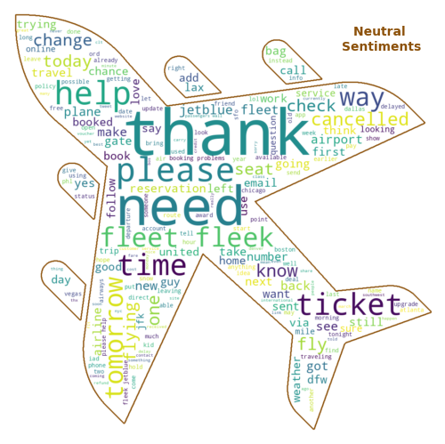

Slide 12
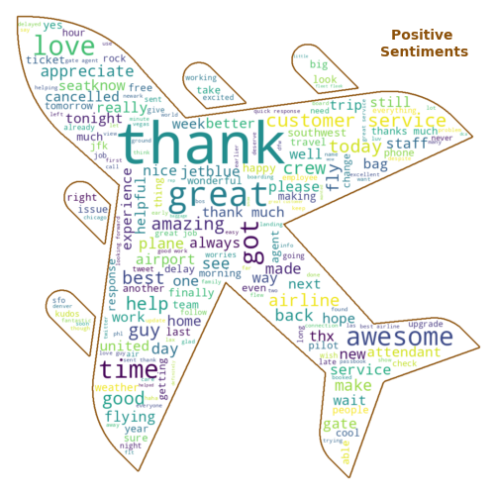

Slide 13

MODELS
LOGISTIC REGRESSION
SUPPORT VECTOR MACHINE
NAÏVE BAYES
BOW size: 8556 words
Test set: 20%

Slide 14
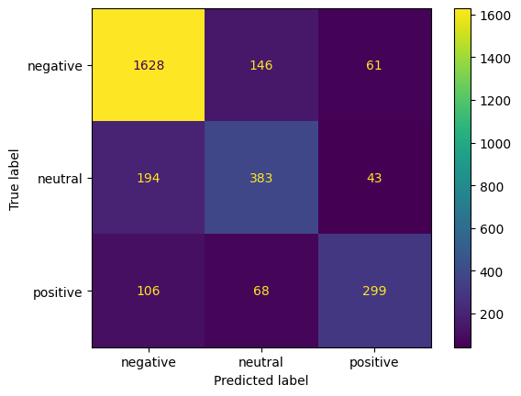
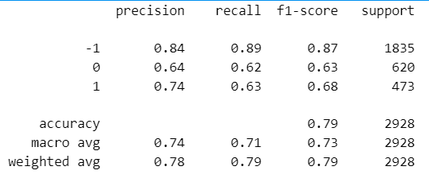
Logistic Regression
Train Accuracy Score: 92.18 %
Test Accuracy Score: 78.89 %

Slide 15
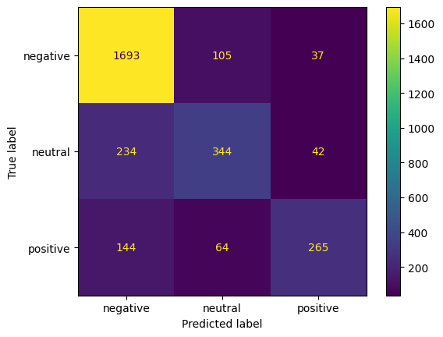
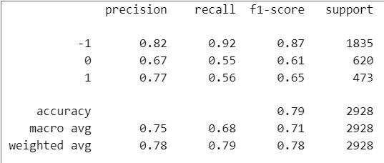
Support Vector Machine
Train Accuracy Score: 91.69 %
Test Accuracy Score: 78.62 %

Slide 16
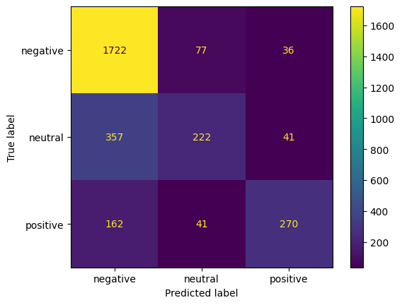
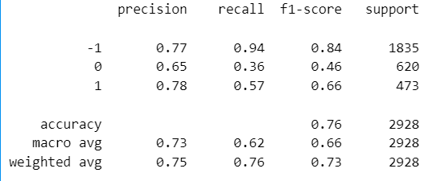
Naïve Bayes
Train Accuracy Score: 83.64 %
Test Accuracy Score: 75.61 %

Slide 17

Hyperparameter Optimization: Stemming and (1,2)-gram BOW
Logistic Regression
Train Accuracy Score: 98.39 %
Test Accuracy Score: 80.40 %
Support Vector Machines
Train Accuracy Score: 93.16 %
Test Accuracy Score: 77.60 %
Naïve Bayes
Train Accuracy Score: 91.44 %
Test Accuracy Score: 72.75 %
(1,2)-gram BOW size: 61100 words

Slide 18

FURTHER RESEARCH RECOMMENDATION
Discard “neutral sentiment”
contains words classified
as negative or positive.
Optimizing algorithm by
concatenating “negative
reason“ and “text” feature.

Slide 19
THANK YOU!

